Slide 1
Workload solution
3/21/2017

Slide 2
Contents
Project motivation
Concrete deliverable
Key technology
Product differentiation
BU sponsorship
Notes:
Executive summary is first.
State the ODT recommendation
At high level cover the triple constraints….1) Scope 2) Costs (P&L) 3) Schedule.
Key Messages
And provide BRIEF highlights of any key RISKS and ACTIONS.
Good place to highlight any HELP NEEDED
Highlight funding needed (reference spend plan in backup) if you required prior to Plan Exit

Slide 3
Needs & Trends
Customer needs
Easy, quick, and consistent deployment of infrastructure, platforms, and applications
Industry trends
Appstore and deployment templates with pre-tested / pre-integrated apps are becoming table-stakes for a competitive Cloud offering
Tech trends
Growing complexity in infrastructure, platforms and applications.
BU needs
Lenovo strength
Lenovo ThinkAgile and Cloud solutions need Appstore and deployment templates to be competitive
Lenovo has a wide range of Cloud infrastructure solutions. A Workload Solution Store will make the portfolio easier to extend, develop, and maintain a competitive edge
More automation in orchestration, deployment, and operation
Solutions team needs technology to automate reference architecture
Manufacturing needs tools to efficiently produce integrated infra
Notes:
Executive summary is first.
State the ODT recommendation
At high level cover the triple constraints….1) Scope 2) Costs (P&L) 3) Schedule.
Key Messages
And provide BRIEF highlights of any key RISKS and ACTIONS.
Good place to highlight any HELP NEEDED
Highlight funding needed (reference spend plan in backup) if you required prior to Plan Exit

Slide 4
Project Background
Vision / Objective:
Deliver the technology as an internal tool to define and deliver solutions on Lenovo hardware (format: operator CLI, workload building tools, web dashboard)
Develop blueprints for Lenovo ThinkAgile Openstack to demonstrate the technology and enable deployment automation on site and in manufacturing (format: packages software, design documents, test suites)
Integrate with xClarity cloud. Provide access to a wide range of end user applications on top (format: provider plugin)
Develop a technology for automated configuration and deployment of Lenovo hardware infrastructure, supported software platforms, and end user applications.
Identify a portfolio of 3rd party applications to create an appstore of pre-integrated applications that would add value to Lenovo ThinkAgile and Cloud portfolios
Deliverable(s) Form:
Value:
Better efficiency and consistency in development, test, and deployment of Lenovo infrastructure solutions
Offer customers a pre-integrated list of applications and workloads on Lenovo offerings
Ease of deploying applications on Lenovo solutions
Enable Lenovo to optimize deployment efficiency and simplify customer implementation
Key enabling technology in xClarity cloud to position Lenovo as a truly open multi-platform cloud technology provider
Lenovo Leadership:
Notes:
a. Use one sentence to clarify the project vision, target or objective.
b. Specify the project deliverables form (such as product, prototype, patent, etc ).
c. Attach the report to illustrate the project value based on tech or industry scan.
d. Answer why Lenovo can achieve innovation leadership through the project implementation.

Slide 5
Core deliverables

Slide 6
Core deliverables
1. Workload blueprints
Rich set of workload blueprints covering all three subject domains: hardware configuration, software defined platform, and user application. In particular, HW workloads will be designed to facilitate deployment and service of ThinkAgile.
Format: packaged software, test suites, design documents, full source code and dev environment
2. Orchestration technology
Includes descriptive language and orchestration runtime binaries that can support Lenovo private cloud solutions and baremetal management tool through a uniformed interface and a HA-ready distributed workload orchestration environment.
Format: Operator commandline, runtime binaries (manager & agent), workload modeling tools
3. Knowledge base & alternative evaluation
Build up internal knowledge base on key technology and workload orchestration alternatives.
Format: team wikis, evaluation reports & slides, demo screencasts & videos

Slide 7
Milestones / Risks / Dependencies
Juju Ironic POC
HW workload
POC
3rd party OpenStack / Kubernetes / Ceph deployment
xClarity provider POC
Define ThinkAgile Ceph model
ThinkAgile workload POC
Orchestrate ThinkAgile Ceph deployment
Apr 15
Jun 30
Sep TBD 2017
Dec TBD 2017
Kickoff
Feb 23
Jun 2017
Aug 2017
Nov 2017
Deliver to DCG
Dependencies
XClarity functionality and API availability STIC XClarity Cloud frontend readiness and integration Orchestration technology vendor built-in dependencies Integration and support plan with DCG is TBD
Risk | Prob | Impact | Owner | Mitigation Plan
Product risk – XClarity lacks core modeling concept to support deployment actions | M | L | Feng X | - Limit scope of XClarity integration to a minimal set of actions XClarity needs to support in integration.
Resource risk – Have insufficient resource to update XClarity API for POC | H | L | Miro H | - Work with Shanghai team for XClarity POC.
Vendor risk – Heavily rely on Canonical technologies, especially its charm store | L | H | Feng X | - Continuously evaluate alternative technologies.
Milestones key:
Lenovo LCTC
Lenovo BU
3rd Party
Notes:
a. Use one sentence to clarify the project vision, target or objective.
b. Specify the project deliverables form (such as product, prototype, patent, etc ).
c. Attach the report to illustrate the project value based on tech or industry scan.
d. Answer why Lenovo can achieve innovation leadership through the project implementation.

Slide 8
Measureable Benchmark
Category | Criteria | Industry Benchmark
Features | Table stakes Full automation Blueprints for hardware configurations, software platforms and applications Lenovo HW and Solutions enablement Differentiation Multi-platform support, both proprietary & open platforms Based on open standards and open source technologies Blueprints for complex hardware configuration | Ansible Playbook and Galaxy Azure application gallery Vmware Solution Exchange
Cost / Performance | Platform deployment under 24 hours Platform re-prevovisioning TBD | Weeks
Notes:
a. Use one sentence to clarify the project vision, target or objective.
b. Specify the project deliverables form (such as product, prototype, patent, etc ).
c. Attach the report to illustrate the project value based on tech or industry scan.
d. Answer why Lenovo can achieve innovation leadership through the project implementation.

Slide 9
System Architecture

Slide 10
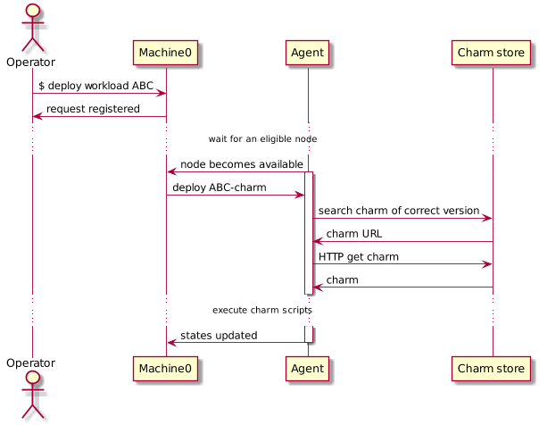
Workload orchestration sequence diagram
Machine-0
Manager node. One per cloud environment. Keep agent states, serve CLI request, and command agents.
Agent
Runtime workload orchestrator. Distributed on each target node.
Charm store
Workload repository. Can be both local & remote.

Slide 11
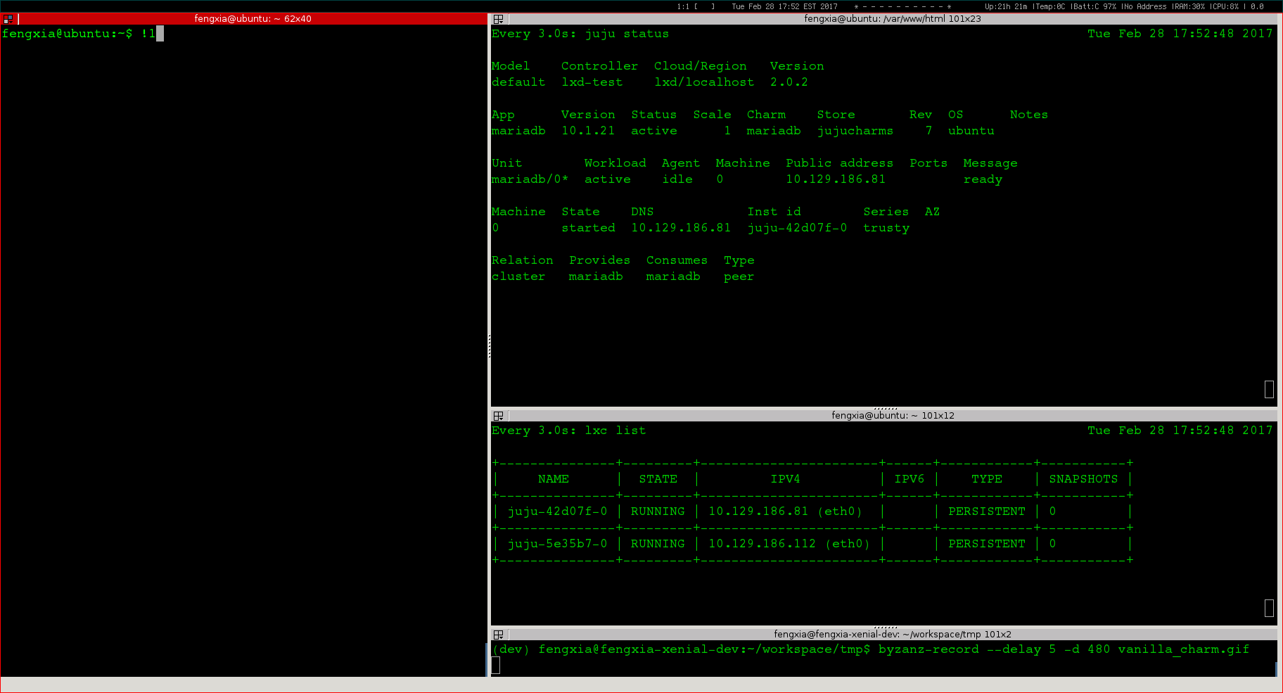
Use case demo: a workload deployment (≈4 min)

Slide 12




System architecture overview
Blueprints
Command to deploy a workload
Hardware
configuration
ie. ThinkAgile
Software platform
Id. Openstack
User application
Ie. Hardoop
Workload metadata
Orchestration manager
3rd party software repo
Baremetal
provider
Cloud provider
ManageIQ
EC2
Ironic
Openstack
XClarity
Rackspace
Node state
Application state
MaaS
Azure
……
……
Platform specific instructions
Workload blueprints
Private Cloud
Public Cloud
Workload software payload

Slide 13
Function Architecture – Level 1
Blueprints
Blueprints
Descriptive template that defines workload states, actions, interfaces, and relations.
Hardware
Ie. ThinkAgile
Platform
Ie. Openstack
User application
Ie. Hadoop
Orchestration
Orchestration technology
Technology that defines terminologies, vocabulary, and runtime engine that enable automated blueprint deployment.
Description language
Orchestration runtime engine
Platform
Platform
Public cloud
Private cloud
Baremetal
Host environment that supports workload requirements and scales dynamically

Slide 14
Level 1 – Blueprints
**Hardware workload
Configure hardware within a hyper-converge rack to establish base line environment such as VLAN, boot sequence.
Blueprints
Platform workload
Hardware
Ie. TA
Platform
Ie. Openstack
User application
Ie. Hadoop
Install OS, agent, and application. Configure system and application to form software-defined platform such as Openstack.
Application workload
Install and configure application and its dependencies.
**
Lenovo innovation

Slide 15
Level 1 – Orchestration technology
Description language
Modeling language written in plain text that describes state, event, component, relation, parameters for installation and configuration.
Orchestration technology
Description language
Orchestration runtime engine
Orchestration runtime
Runtime binary that parse blueprint, responds to state change and event, and execute built-in function and custom scripts.

Slide 16
Level 1 – Platform
Public cloud
Amazon AWS
Azure
Rackspace
GCE
Platform
Private cloud
Public cloud
Private cloud
Baremetal
Openstack
ThinkAgile
Baremetal
Lenovo/xClarity cloud
HP
Dell

Slide 17
Function Architecture – Level 2
Workload Repository
Blueprint store
Workload Service
System optimization & big data
Workload Designer
Design, development and testing tools
Workload Orchestration Runtime System
Orchestration Manager
Central management server, one per platform service
Workload Manager
Distributed agent, one per deployment target
Software Platform Provider
Platform plugin interface & driver
Platform Service Provider
Host environment on demand

Slide 18
Function Architecture – Level 3
Workload Repository
Workload Service
Workload registry
Metadata service
Authentication
Version manager
Configuration filter
Utilization score card
Blueprint pipeline
Workload optimization
Workload Designer
Workload Orchestration Runtime System
Description language
Orchestration Manager
Workload Manager
API server
Node registry
Node lifecycle management
Node auditor
Workload downloader
Workload parser
Template creator
Data store
Configuration manager
Model manager
RPC interface
Workload installer
Workload cleaner
Workload compiler
Cloud provider plugin interface
Constraint checker
Workload version control
Websocket data transporter
State engine
API client
Workload linter
Node authentication
User CA generator
Workload agent provisioner
Worker thread manager
Error handler
Configuration management
Workload packaging mgt
Dry run sandbox
Software Platform Provider
Amazon EC2
GCE
Azure
Opensack
Cloudsigma
Rackspace
Workload editor
Joyent
Vsphere
MAAS
LXD container
Ironic
xClarity
Dependency illustrator
Platform Service Provider
Machine discovery
Machine inspection
Machine inventory
Power mgt
Network service
Storage service
Hypervisor service
Container service

Slide 19
Key Technology

Slide 20
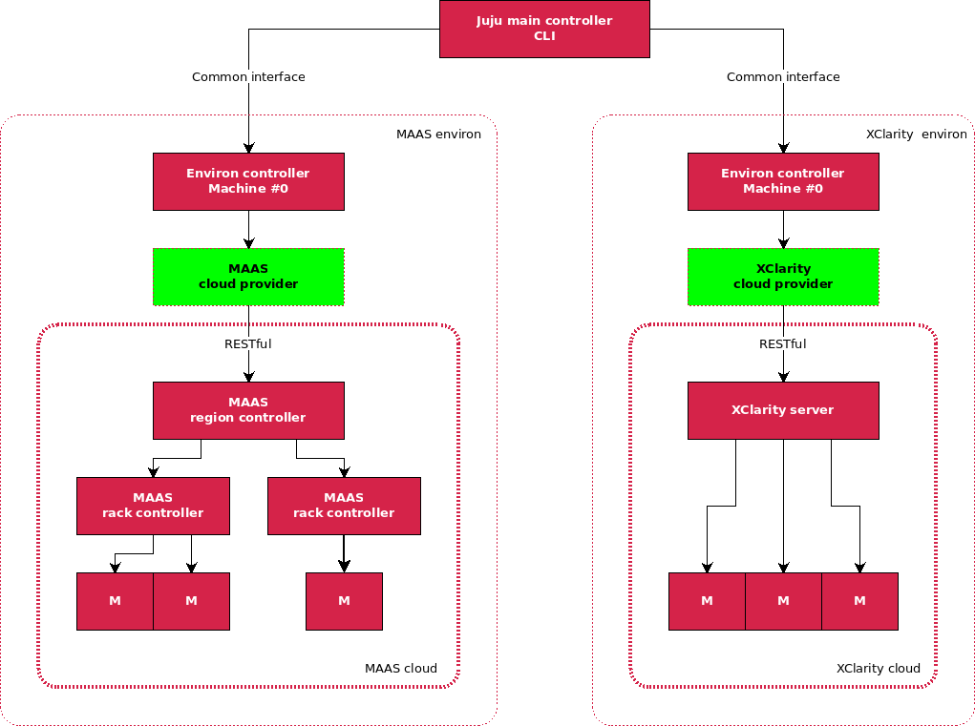
Juju - xClarity cloud model
xClarity cloud
Same configuration to support both public clouds and private cloud.
Extend “provider” to enable integration with xClarity.
Workload becomes “cloud” agnostic.

Slide 21
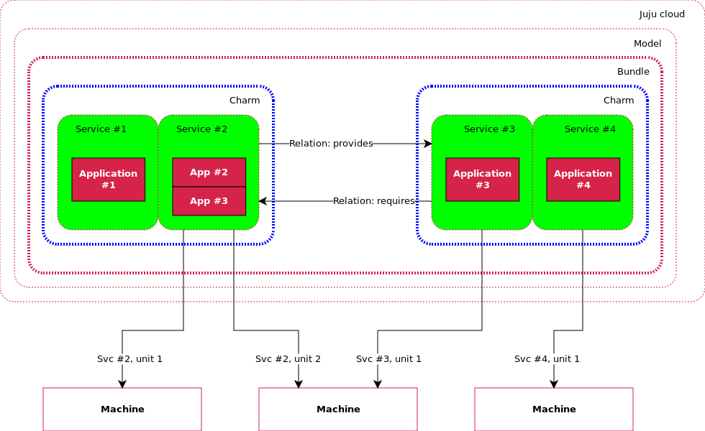
Workload model (charm)
Workload charm
Base unit is a “service”.
Service can have more than 1 units to achieve HA.
Deployment can be on BM, VM, and LXD container.
High availability

Slide 22
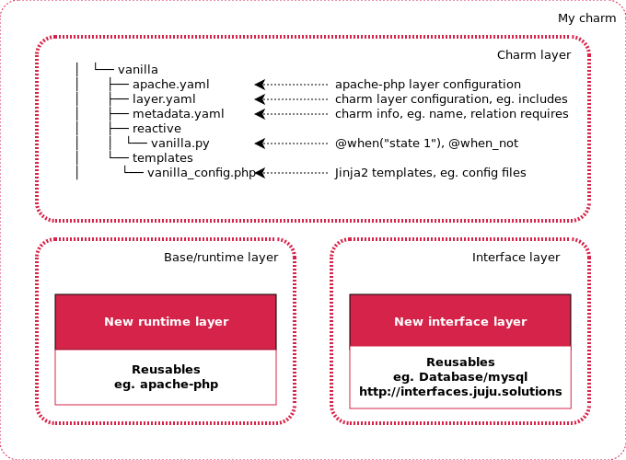
Reactive workload & inheritance
Base layer
Provides foundation service that can be reused.
Interface layer
Defines service that can be “connected” to, eg. DB. Parameters are managed by charm; connection method is determined by the application.
Application layer
Defines “states”, “hooks” and application logics.
Notes:
Base layer
Interface layer defines service that can be “connected” to, eg. DB. Parameters are passed via interface; how to connect is determined by application, not charm.
Charm layer defines “states”, “hooks”, and application logics.

Slide 23
Workload event lifecycle hooks
install
config-changed
start
upgrade-charm
stop
update-status
leader-elected
leader-settings-changed
[name]-relation-joined
[name]-relation-changed
[name]-relation-departed
[name]-relation-broken
[name]-storage-attached
[name]-storage-detaching

Slide 24
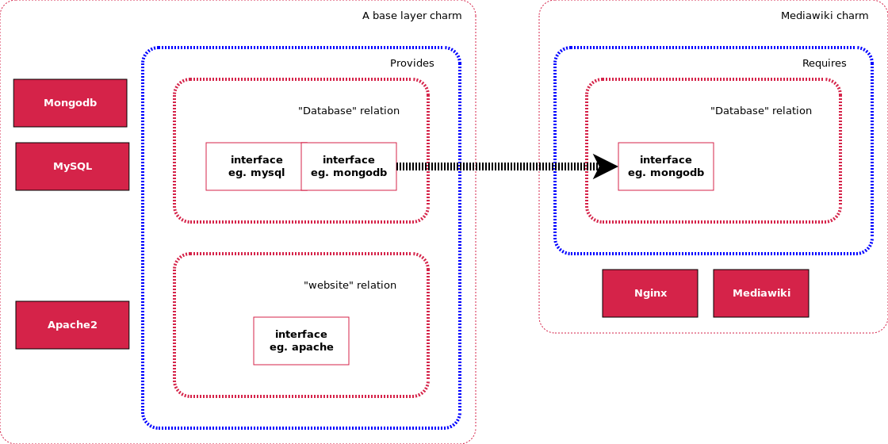
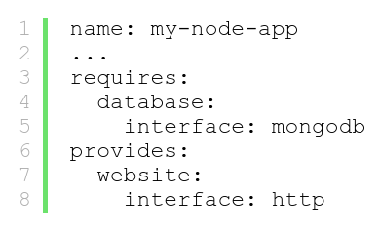
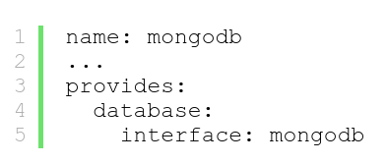
Workload interface sharing
Interface must match
Define a relation category

Slide 25
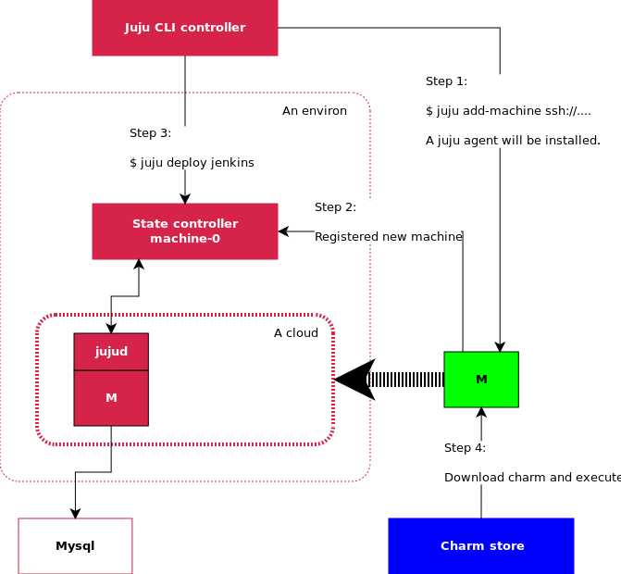
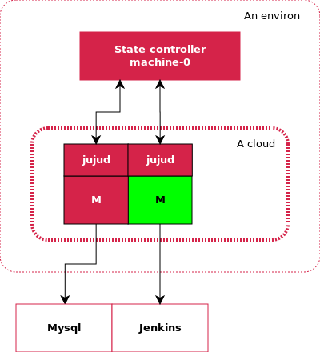
Workload deployment: Before & After
Before
After

Slide 26
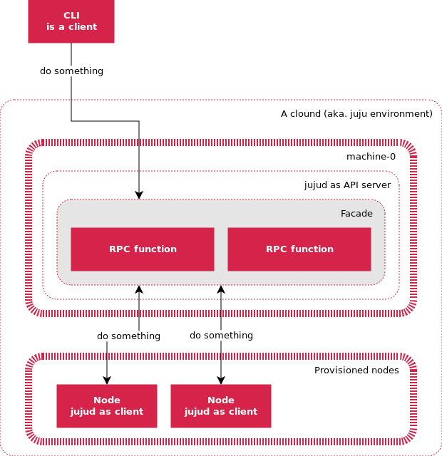
Workload agent
Agent is distributed on each deployment target “machine”.
Agent is installed as part of node provisioning process, then runs as systemd service.
Agent communicates to management node via websocket transportation layer (on server port 17070).
API server provides the same RPC interface for both workload agent and commandline tools.
Agent has a unique ID and credential issued by manager node.

Slide 27
Product Differentiation

Slide 28
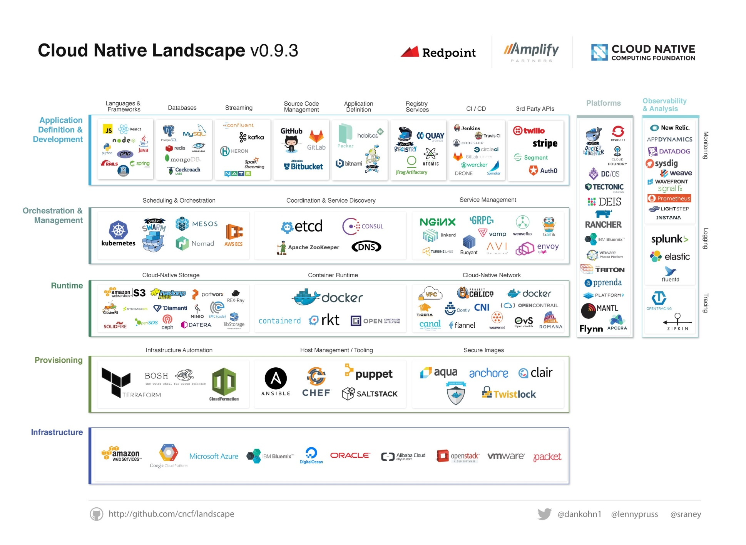
Cloud Native Landscape – Need for a Solution Store
Many different applications
Highly interactive
Many different Clouds
From Private On-Prem to Public
Many cookbooks to deploy
Need a simple and common framework to deploy and scale

Slide 29


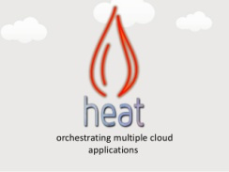




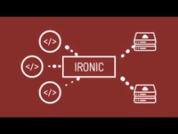

Competitive Landscape (Alternatives to Juju Charms)
App Store
Orchestration
Bare Metal Services
Note: Ansible, Chef, Puppet are Configuration Management tools

Slide 30
Competitive Landscape
 | ZeroStack | Stratoscale | Canonical | Red Hat | Mirantis | VMware
App Store + Orchestration | Z-AppStore + Z-Brain | Application Catalog | Juju + Charms | Red Hat Cloudforms (Ansible) | OpenStack Murano | Vmware Cloud Mgmt marketplace + vRealize

Slide 31
BU Sponsorship

Slide 32
Project Team / Stakeholders / Sponsor
Project Team
Feng Xia Project Lead
Rich Wellum Scrum Lead
Xiaogang Zhou Code
Pramodh Mallipatna Marketing
Stakeholders
Sponsor:
xClarity
ThinkAgile Team
Lenovo IT
STIC
Notes:
a. Use one sentence to clarify the project vision, target or objective.
b. Specify the project deliverables form (such as product, prototype, patent, etc ).
c. Attach the report to illustrate the project value based on tech or industry scan.
d. Answer why Lenovo can achieve innovation leadership through the project implementation.

Slide 34
Back up

Slide 35
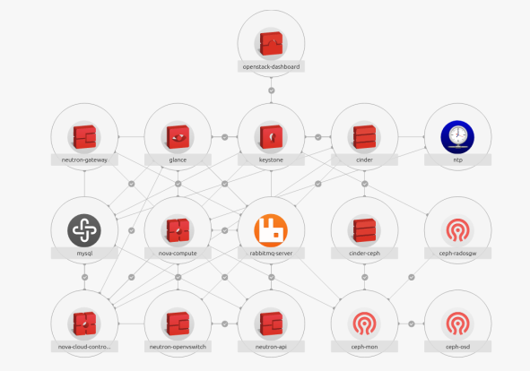
SDDC: Workload Solution Store
Incubation
What / Objective:
Identify and adopt industry leading infrastructure and workload modeling technology and library so to leverage preexisting workload repository
Create baseline end-to-end implementation and technology portfolio suitable for modeling and provisioning of ThinkAgile Ceph infrastructure and workloads on top of it
Who:
Target BU – DCG
Project Leader – Feng Xia
When / Milestone:
March 2017: Decide on Juju / Charms suitability for orchestration
June 2017: 3rd party OpenStack/Kubernetes/Ceph deployment
Sept 2017: Define ThinkAgile Ceph model
Dec 2017: Orchestrate ThinkAgile Ceph deployment
TBD: BU hand-over
BU Dependencies:
XClarity functionality and API availability
STIC XClarity Cloud frontend readiness and integration
Orchestration technology vendor built-in dependencies
Integration and support plan with DCG is TBD
Notes:
KPI
Orchestrate deployment of 3rd party application on single bare metal server using XClarity and/or Ironic
Orchestrate pre-packaged OpenStack/Kubernetes/Ceph through XClarity and/or Ironnic
Model and orchestrate ThinkAgile Ceph deployment
Resource Plan
Minimum Required: 4 (UI/UX: 1, OpenStack dev: 2, PA: 1)
Growth Plan: 8 (UI/UX: 2, OpenStack dev: 4, PA: 2)
Gap/Dependency
XClarity functionality and API availability
STIC XClarity Cloud frontend readiness and integration
Orchestration technology vendor built-in dependencies

Slide 36
SDDC: Workload Solution Store
Incubation
BU Needs:
CI/HCI BU requested capability to deploy workloads
Proof points for Lenovo as total stack provider
Industry Trends/Tech. Trends:
One click workload deployment
Lenovo innovation leadership :
Deployment and performance optimization
Total stack of CI/HCI
Notes:
KPI
Orchestrate deployment of 3rd party application on single bare metal server using XClarity and/or Ironic
Orchestrate pre-packaged OpenStack/Kubernetes/Ceph through XClarity and/or Ironnic
Model and orchestrate ThinkAgile Ceph deployment
Resource Plan
Minimum Required: 4 (UI/UX: 1, OpenStack dev: 2, PA: 1)
Growth Plan: 8 (UI/UX: 2, OpenStack dev: 4, PA: 2)
Gap/Dependency
XClarity functionality and API availability
STIC XClarity Cloud frontend readiness and integration
Orchestration technology vendor built-in dependencies

Slide 37
Risks / Work Items
Risk | Prob | Impact | Owner | Mitigation Plan
Product risk – XClarity lacks core modeling concept to support deployment actions | M | L | Feng X | - Limit scope of XClarity integration to a minimal set of actions XClarity needs to support in integration.
Resource risk – Have insufficient resource to update XClarity API for POC | H | L | Miro H | - Work with Shanghai team for XClarity POC.
Vendor risk – Heavily rely on Canonical technologies, especially its charm store | L | H | Feng X | - Continuously evaluate alternative technologies.
Work Items | Owner | Target | Status
Build Juju+MAAS research lab | Feng X. | 1/31 | - Demo capable
Study feasibility to build XClarity driver in Juju | Feng X. | 1/31 | - We have developed a new provider and identified hooks to integrate with XClarity .
Research and simulate juju bootstrap process. | Feng X. | 2/28 | - We have a fair understanding of this process. More research needed in its provisioning process.
Research and simulate charm deploy process. | Feng X. | 2/28 | - We have a good understanding of this process. More research needed in agent communication mechanism.
Develop capability to create new charm and install from local charm store. | Feng X. | 4/31
Develop POC to demonstrate end-to-end workload creation to deployment. | Feng X. | 4/31
Develop POC to deploy Openstack/Ceph charm to bare metal using XClarity integration. | Feng X. | 6/30
Develop POC to deploy ThinkAgile or product in similar scale to bare metal. | Feng X. ThinkAgile team | 10/30
Alternative technology evaluation | Feng X. | On-going basis

Slide 38
Success Factors
Key factors for success
Integrate Workload Solution Store with Lenovo Solutions (manufacturing, packaging, sales)
Develop the required service / support structure to train customers
Develop a Lenovo partner ecosystem with 3rd party Cloud Applications
Key Dependencies and Risks
Buy-in from DCG product, services and sales teams
Key Actions
Evaluate if Juju Charms is the right technology or should it be based on a alternate technology
Interlock with WW Geo/Sales teams to identify customer interest for PoC / technology adoption

Slide 39
Resource Plan
Human Resource (Person*Month)
FTE/正式员工 |  |  |  | Contractor/外包岗
R&D Expenses ($K) |  |  |  | Note
Onsite expenses
NRE Fee
Mockup
Machining/加工费
Research Material/研发材料
Testing/Certification/实验检验费
Others
R&D Expenses Total
Notes:
a. Use one sentence to clarify the project vision, target or objective.
b. Specify the project deliverables form (such as product, prototype, patent, etc ).
c. Attach the report to illustrate the project value based on tech or industry scan.
d. Answer why Lenovo can achieve innovation leadership through the project implementation.

Slide 40
Business Case
Business Model | Solution store will be offered for free Solution store will be a facilitator to deploy applications easily Monetize through Applications integrated into the Solution Store (so long as they are not Open Source) Value capture through increased value of Lenovo Cloud solutions
Monetize
ThinkAgile
Cloud solutions
Applications
Develop
Workload Solution Store
Invest
Value

Slide 41
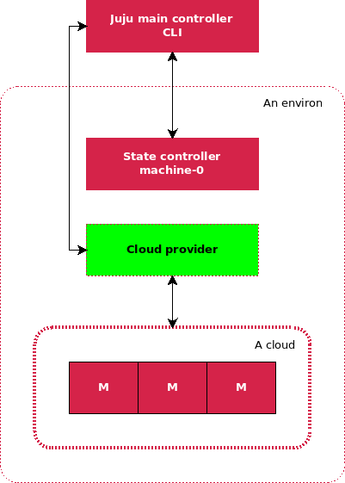
Juju cloud model

Slide 42
Executive Summary – Workload Solution Store
Juju Ironic POC
3rd party OpenStack / Kubernetes / Ceph deployment
Define ThinkAgile Ceph model
Orchestrate ThinkAgile Ceph deployment
Milestones
Apr 15
Jun 30
Sep TBD 2017
Dec TBD 2017
Kickoff
Feb 23
Concept
TBD
Deliver to DCG
Objective:
Identify and adopt industry leading infrastructure and workload modeling technology and library so to leverage preexisting workload repository
Create baseline end-to-end implementation and technology portfolio suitable for modeling and provisioning of ThinkAgile Ceph infrastructure and workloads on top of it
Milestones key:
Lenovo LCTC
Lenovo BU
3rd Party
Product Description | Workload solution store with Pre-integrated list of Lenovo supported applications and workloads Integrated with Lenovo solutions
Target Market | Internal customers Lenovo Manufacturing & Lab Operators Lenovo Professional Services Lenovo DCG Solutions group External customers Cloud operators Enterprise IT operators / DevOps environments
Value Proposition | Offer a pre-integrated list of applications and workloads on Lenovo offerings Ease of deploying applications on Lenovo solutions
Business Model | Solution store will be offered for free Solution store will be a facilitator to deploy applications easily Monetize through Applications integrated into the Solution Store (so long as they are not Open Source) Value capture through increased value of Lenovo Cloud solutions
GEO Availability | All Geos where Lenovo solutions are sold
Volume Target | Tied to Lenovo solutions
Stakeholders
xClarity
ThinkAgile Team
Lenovo IT
STIC
Core Team
Feng Xia > Lead
Rich Wellum > Scrum Master
Xiaogang Zhou > Code
Pramodh Mallipatna > Marketing
Notes:
Project Deep Dive Agenda:
Project motivation
Concrete deliverable
Key technology
Product differentiation
BU sponsorship

Slide 43

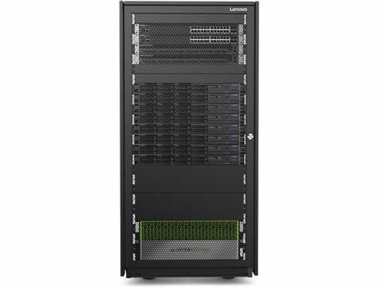
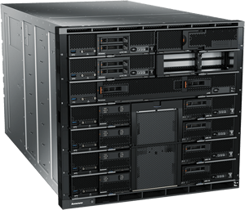
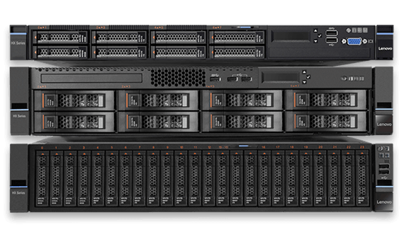





Workload Solution Store – Concept and Value
App Store
Workload Orchestration
Lenovo ThinkAgile
Lenovo Cloud Solutions

Slide 44













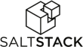






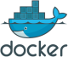



Cloud Native Applications
Architectural paradigm
Designed specifically for running in the Cloud i.e. designed to work with loosely coupled Cloud Services
Tasks broken down into services (aka microservices) that can run on different servers and multiple locations
Redundancy is built into the architecture to withstand failures
Advantages
Scales out easily (much better than traditional architectures)
Reduces the need for over-provisioning of the infrastructure
Improves time to bring applications to life significantly
Creates a API based interaction and collaboration between apps
Hadoop
noSQL DB
Message Queue
Microservices
DevOps
IaaS
Container
Infrastructure

Slide 45



Marketing Messages
Pre-integrated applications and workloads
Pre-integrated list of applications and workloads with Lenovo Cloud solutions
Easy deployment and scaling of workloads
Deploy and scale Cloud applications and workloads easily with Lenovo solutions
Common framework to deploy all workloads
Co-existence in mixed environments
Workloads can be deployed across Lenovo and non Lenovo solutions, enabling mixed environments

Slide 46
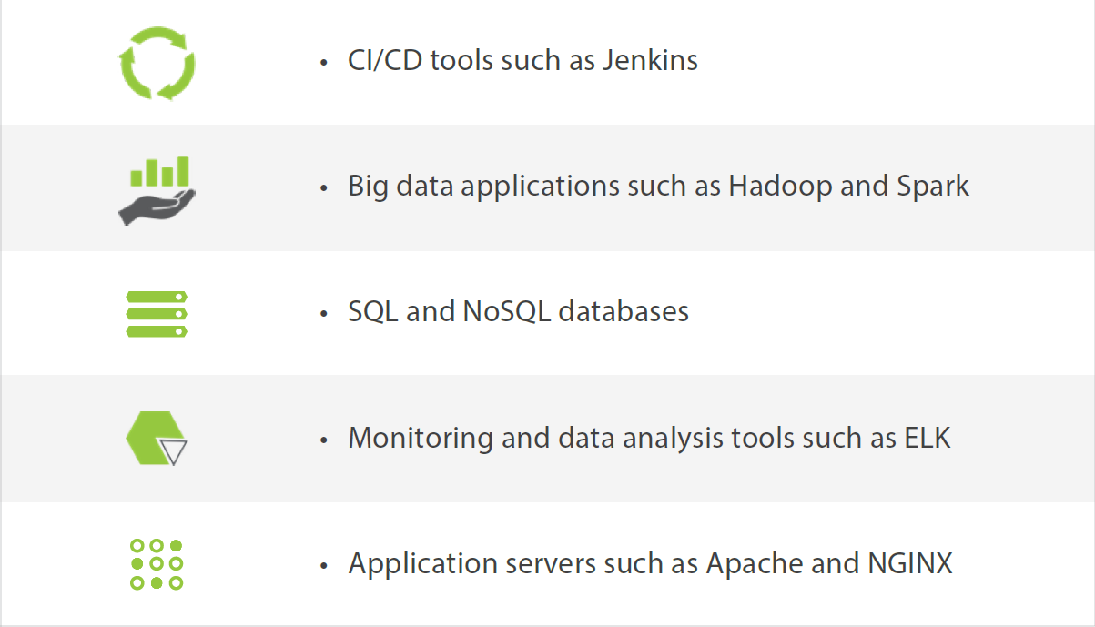
Applications / Workloads to be part of Solution Store
Example of types of applications / workloads part of Zerostack Z-AppStore
Develop templates and orchestration mechanism to install and operate the workloads
Use Open Source based apps where possible and integrate with 3rd party apps where there are business synergies
Create an ecosystem of popular apps in these areas to be part of app store

Slide 47
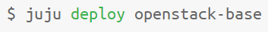
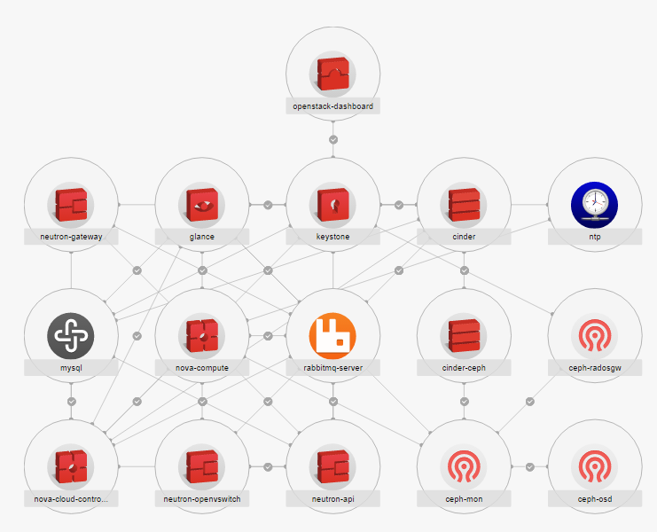
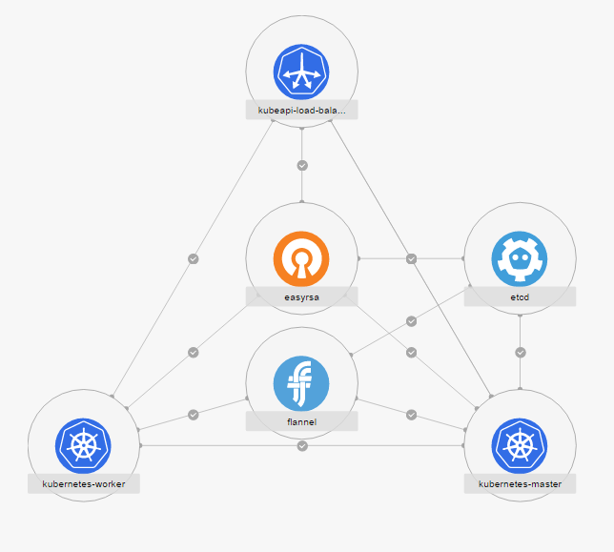
Example Use Cases

Slide 48
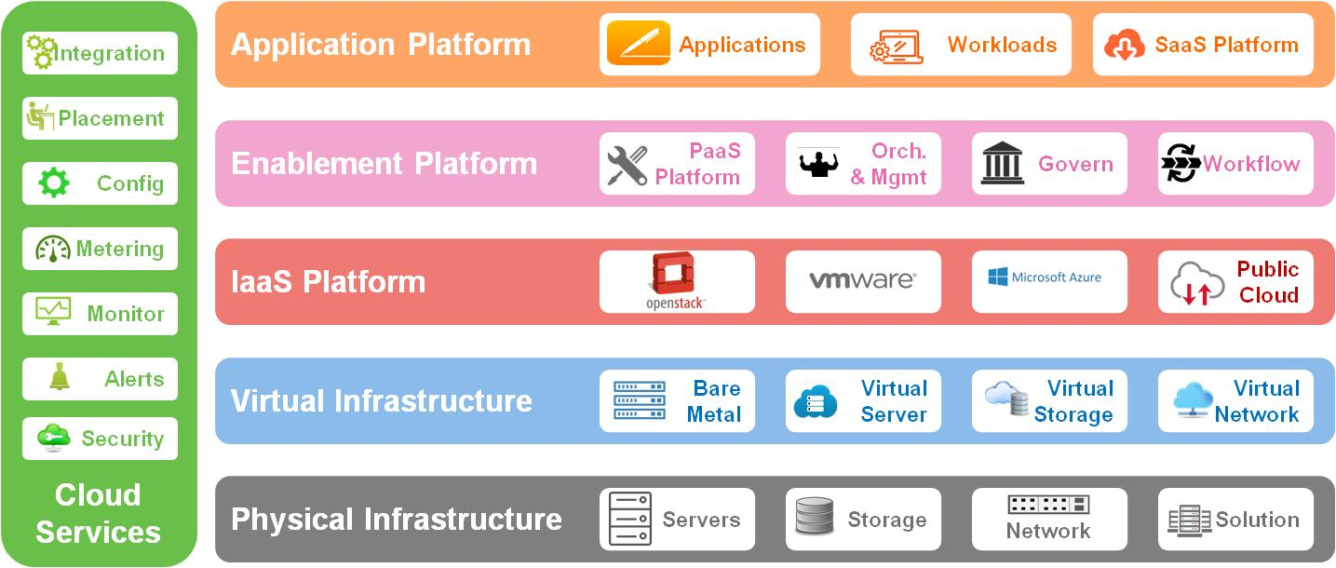
Portfolio Positioning
Workload Solution Store
Lenovo Solutions Portfolio

